Slide 1
Baildon Youth Council Oct-Dec Report

Slide 2
General update/highlights
Youth Council members x 5
3 total staff members
We have established a great working partnership with Bradford Youth Service, and have two staff who have been working alongside us consistently since November.
6 x Young councils members transitioned into further education and employment assisted by the skills gained from their involvement in youth council
Young people still making progress towards New objectives sept for 2021 - 2022
Youth council carried out a Halloween event for Tuesday 26th October which was the opening for their open access youth club weekly on Tuesdays.

Slide 3
Objectives
Community involvement – once a month from July 2021
Youth council members to be involved in the running of the open access youth group
Education sessions
Awareness sessions – including drop IN SESSIONS – consultations
Have fun, SAFELY.

Slide 4
Did we meet our objectives Sept - Dec 2021?
Community involvement – Yes. The BYC were involved in 4 community events. (see the following slides)
Youth council members to be involved in the running of the open access youth group - Yes, we successfully have opened up an open access youth group.
Education sessions - We have been prioritising the promotion and running of the youth club sessions since November 2021 but now that we have a regular group of 14 young people attending, this will be a priority in the quarter. We have already identified a range of topics which we will be covering each week. For example; The BYC have developed a presentation on gender inequality that will be ready for delivery soon.
Awareness sessions – including drop IN SESSIONS – consultations - Yes, the BYC have advocated for several awareness sessions based on their experiences.
Have fun, SAFELY. - Yes. Met throughout all our activities and engagement e.g Young People’s involvement in monthly planning, ground rules and behaviour plan

Slide 5
Quotes about open access
‘Thank you for giving them all something to do and keeping them off the streets.’
‘Thank you for letting L join, he said he liked playing football there with his friends, its nice that he can go somewhere and play with his friends with the dark nights, I don’t really let him play out in the dark so thank you. I appreciate what you’re doing.’
‘I am so happy they have some where to go.’
‘They really enjoy going, its somewhere safe they can go to hang out with their mates.’
‘It gets them doing something for the community which is good for our neighbourhood.’
‘there’s not much to do in this area, so it nice to have somewhere to participate’

Slide 6
Benefits of the Open access youth group:
Reduces social isolation among young people in the Baildon area
Improves life skills of young people by offering a range of activities including cooking and CV workshops
Increases the independence of young people by giving them a space that is their own, where they get to decide and influence what happens.
Tackles anti-social behaviour by getting young people off the streets and into a productive youth group
Improves community relations as young people are engaged in work to benefit the community such as litter picks

Slide 7
Feedback from BYC members.
‘It was our idea to start a youth group to engage more young people in our area. We wanted to create a fun, social and informative environment. Hearing this feedback makes us feel like we have really achieved something and done our job well. It also makes us feels valued and gives us responsibility in preparing for our future’

Slide 8
Community outreach
Hale Christmas fair - the HALE team organised a community fair at the Kirkgate centre in Shipley in order to raise money for the charity. The youth council members attended in order to offer assistance with the running of the event as well as talking to isolated members of the community who attended; building on their previous inter-generational work.
Plastic free Shipley - The Baildon youth council members began a consultation with a representative from Plastic free Shipley where they outlined that they would begin by making the sessions plastic free and seeing where they could go from there.

Slide 9
Community outreach (cont)
COP – two of our BYC attended a community assembly to discuss COP26, share their ideas and learn from others. The young people spoke about new ways to fight against the environmental crisis, then presented their findings to the assembly. Afterwards, the young people claimed to feel empowered and heard; one in particular stated “my confidence was greatly improved.”
Salts Drop in - The BYC assisted the Baildon staff in delivering and providing a mental health drop in at Salts School. Including planning awareness topics as well as advocating for what matters to young people.
Open access sessions – The youth council now help to facilitate an open access youth group at St. Huws. Young people from around the area have come to the sessions and enjoyed games, crafts and cooking as well as issue based sessions.

Slide 10
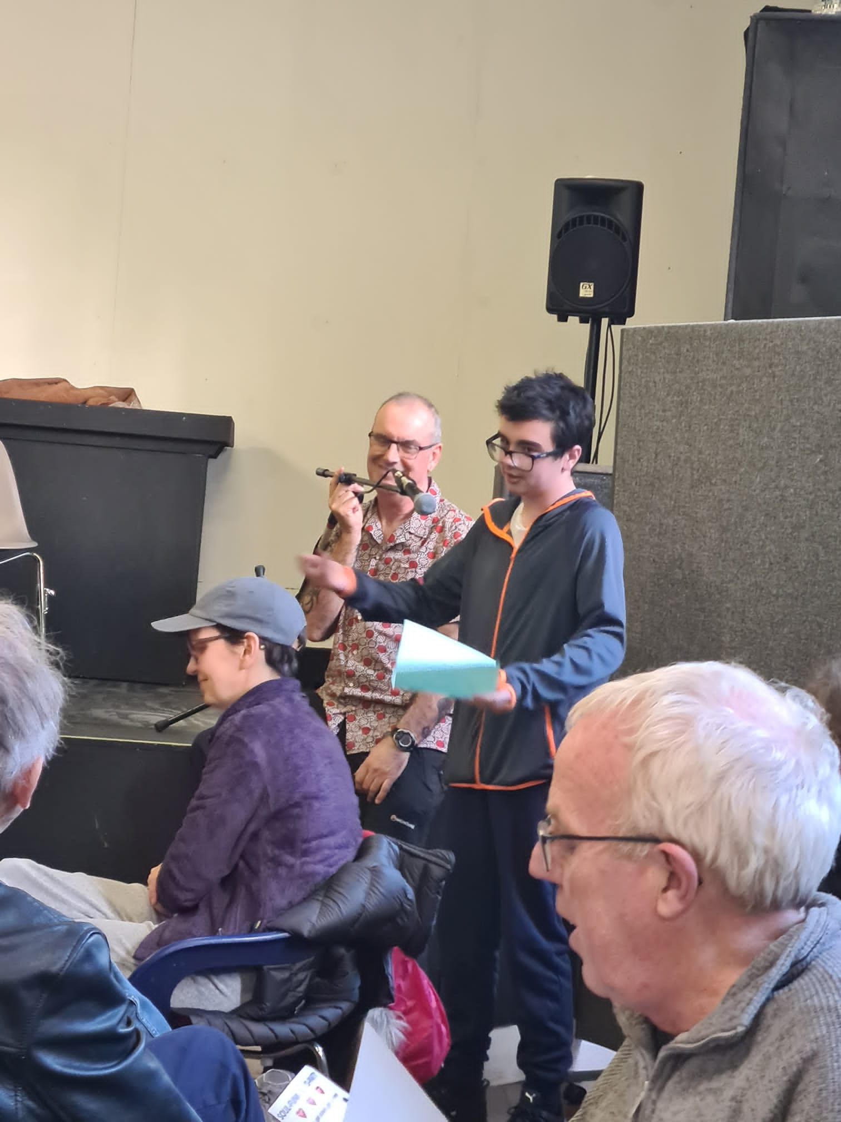
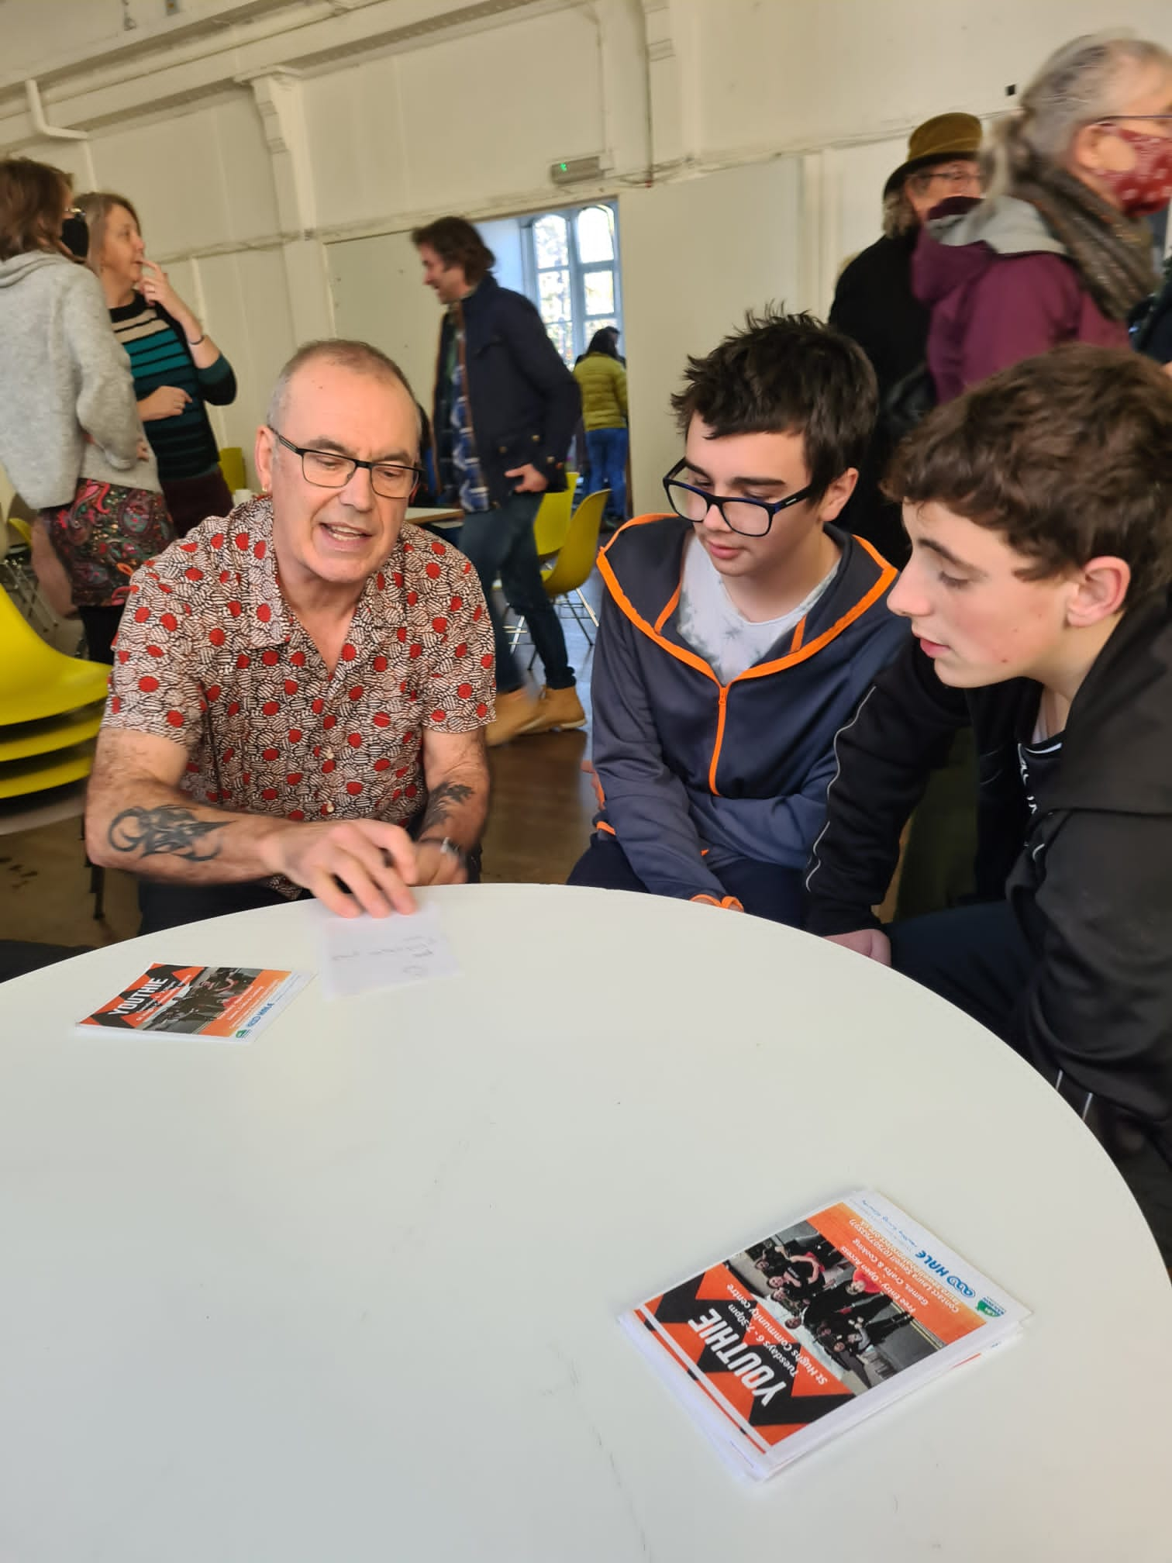
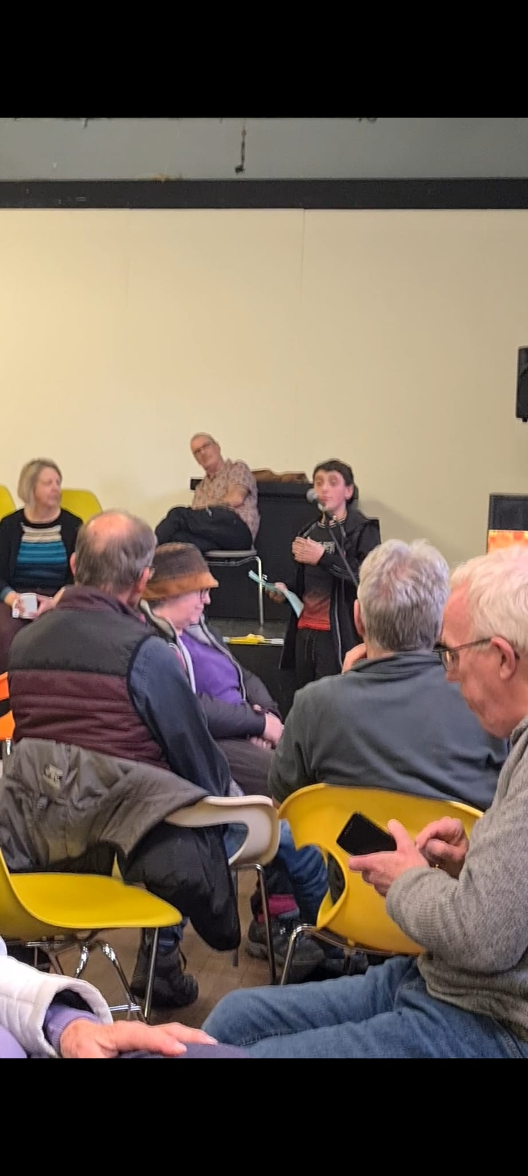
Community outreach
COP26

Slide 11
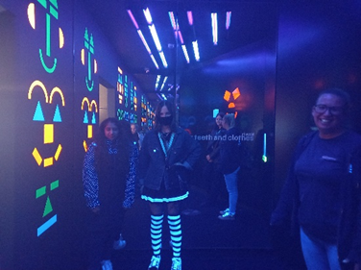
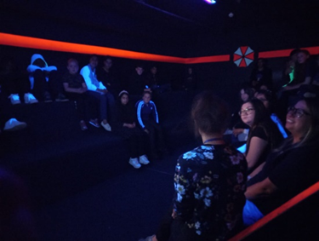
Additional Activities:
The Youth Council operated a buddy system for the HALE Christmas laser zone bonanza; accompanying and assisting socially isolated and vulnerable young people.

Slide 12
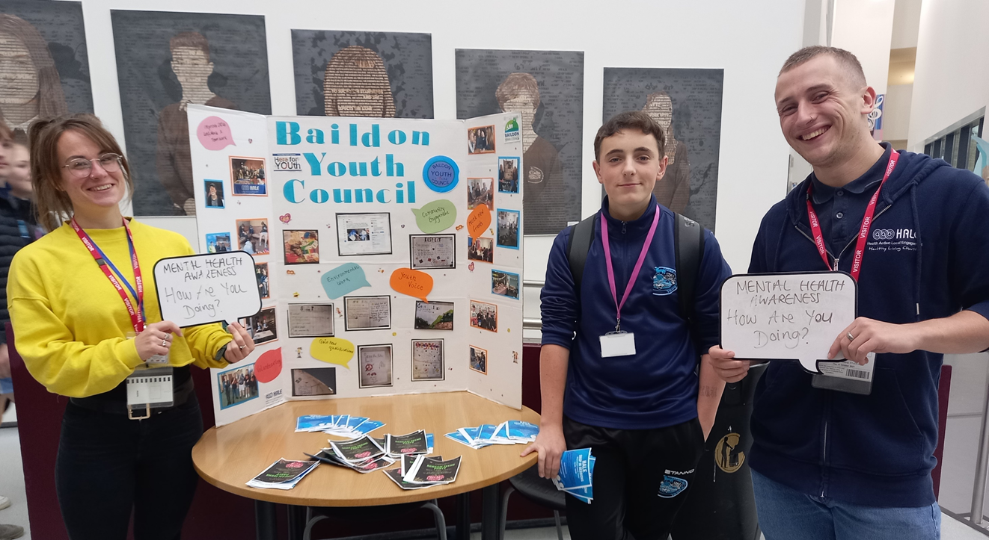
Awareness Activities
Mental health
Promoting British Youth Council Mental Health Campaign.
We want our Parliament to: Recognise that our minds matter, and improve the access to and quality of our mental health services.

Slide 13
Educational Sessions
Healthy Eating workshops: We have delivered a number of different healthy eating workshops where interesting meals were demonstrated to both the members of the open access group as well as the BYC

Slide 14
How we had fun!
Football
BOARD GAMES
Food!

